Slide 1
Character Analysis Generation
Longformer w/ Seq2Seq, Coreference Resolution
Ajay Bati, Nyimul Hoque, Rahul Komatineni

Slide 2
Outline
Motivation
Project Goal
Implementation
Results

Slide 3
Motivation/Journey
We wanted to look at a novel, and:
Understand character arcs
Understanding how characters are affected by each other

Slide 4
Project Goal
Challenges with this goal:
Books and literary pieces are extremely long for NLP models
We worked with the LiSCU dataset which contained character descriptions and summaries of the novels they appear in
Create a character analysis of their character arc, based off of raw book text.

Slide 5
Implementation

Slide 6
Implementation Pipeline
Coreference Resolution
Longformer Model
Reinforcement Learning
Replacing pronouns
For example: we took a novel such as Harry Potter and the Philosopher’s Stone and replaced every pronoun referring to Harry Potter with his name
Trained on LiSCU
Longformer trained on character descriptions
Then we ran the Longformer on val dataset and our own makeshift summaries
Output based learning
Remove unneeded, distracting information from the summaries to produce better character descriptions

Slide 7
Coreference Resolution
GAP Coreference Dataset
Layer 9 Head 2 seemed to perform the best for Coref resolution
Creating custom dataset
Mock character summary per chapter
She tried again. 'I need this code. I'll take your code and add it to mine. Don't you understand?', she asked Mark and Amy.
She tried again. 'I need this code. I'll take Mark and Amy code and add the code to mine. Don't Mark and Amy understand?', she asked Mark and Amy.

Slide 8
Longformer
Based on allenai/led-base-16384
Updated model of original longformer
Increased token size for input sequence length
Necessary for books
Encoded and decoded with the seq2seq trainer from hugging face

Slide 9
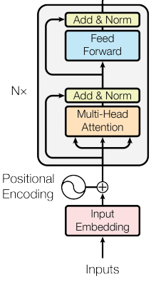
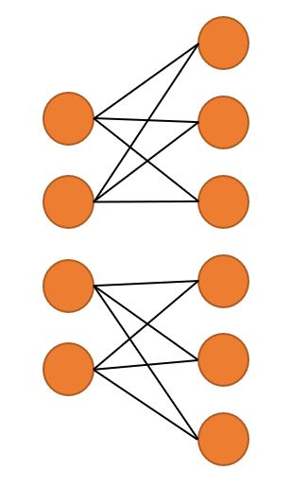
REINFORCE
0.1,0.2,0.3,0.8,0.9
RL AGENT
Candidate summary vs gold summary

Slide 10
Extracted Summaries
A Connecticut Yankee in King Arthur's Court
529 tokens
Hank Morgan runs a munitions and machinery factory in 19th-century Connecticut. He's struck by a crowbar during a dispute with the workers, and wakes up thirteen centuries in the past. A knight from King Arthur's Court takes him prisoner, and Arthur orders him executed. Hank escapes by "predicting" an eclipse and claiming that he could blot out the sun if they executed him. Hank becomes the King's prime minister—a.k.a. ………
2722 tokens
Hank Morgan runs a munitions and machinery factory in 19th-century Connecticut. He's struck by a crowbar during a dispute with the workers, and wakes up thirteen centuries in the past. A knight from King Arthur's Court takes him prisoner, and Arthur orders him executed. Hank escapes by "predicting" an eclipse and claiming that he could blot out the sun if they executed him. Hank becomes the King's prime minister—a.k.a. ………

Slide 11
Results

Slide 12
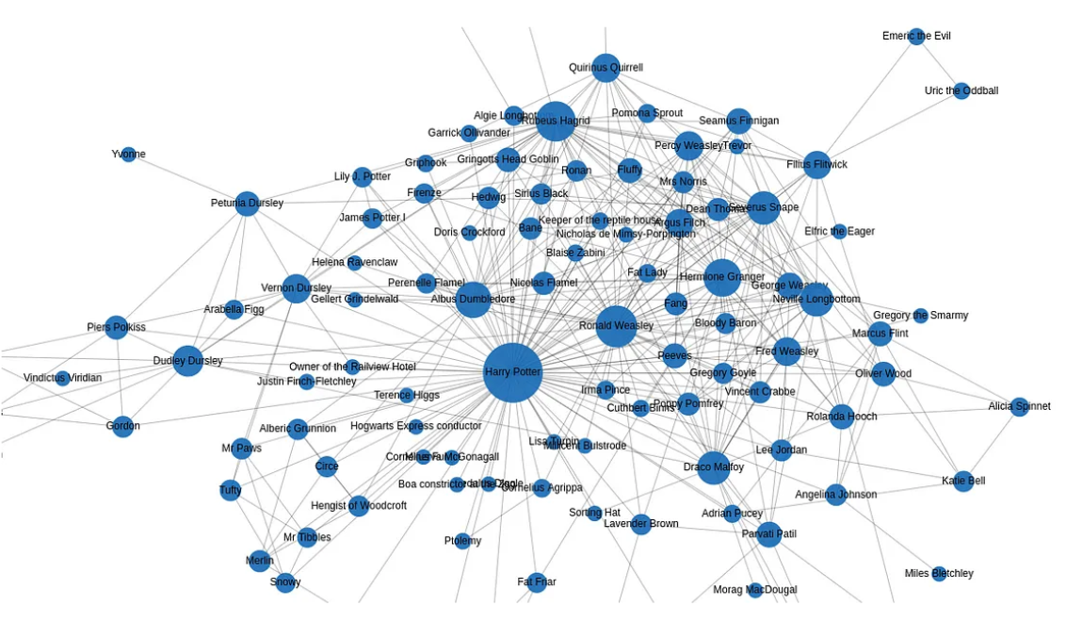
Character Graph
Harry Potter and the Philosopher’s Stone
Aliases from both fandom and our knowledge
Used coref resolution
Stored to neo4j database for visualization

Slide 13
Book Summary
Gold Label Character Description
Winston Smith is a member of the Outer Party. He works in the Records Department in the Ministry of Truth. To escape Big Brother\'s tyranny, at least inside his own mind, Winston begins a diary — an act punishable by death. Winston is determined to remain human under inhuman circumstances. One day, while at the mandatory Two Minutes Hate, Winston catches the eye of an Inner Party Member, O\'Brien, whom he believes to be an ally. He also catches the eye of a Julia whom he believes is his enemy and wants him destroyed. A few days later, Julia, secretly hands him a note that reads, "I love you." Eventually, Winston and Julia confess to O\'Brien, whom they believe to be a member of the Brotherhood.. O\'Brien welcomes them into the Brotherhood with an array of questions. Initially Winston believes that O\'Brien has also been caught, but he soon realizes that O\'Brien is there to torture him and break his spirit. The Party had been aware of Winston\'s "crimes" all along; in fact, O\'Brien has been watching Winston for the past seven years. O\'Brien spends the next few months torturing Winston in order to change his way of thinking — to employ the concept of doublethink, or the ability to simultaneously hold two opposing ideas in one\'s mind and believe in them both. Winston believes that the human mind must be free, and to remain free, one must be allowed to believe in an objective truth, such as 2 + 2 = 4. O\'Brien wants Winston to believe that 2 + 2 = 5, but Winston is resistant. In the end, there is no doubt, Winston loves Big Brother.
Winston, the novel's protagonist, is staunchly against the Party. He finds unobtrusive methods to rebel, or at least he believes them to go unnoticed. He main desire is to remain human under inhuman circumstances.
Character Description
A member of the Outer Party and the narrator of Two Minutes Hate. He is the protagonist of the novel, and he is the only character who is able to remain human under inhuman circumstances. He believes that the human mind must be free from the tyranny of Big Brother and the Party, and that the only way to do that is to be human. He begins a diary, an act punishable by death, in order to escape Big Brother's tyranny. Winston's diary is his only form of communication with the outside world, and it is through it that he learns the secrets of the Party and its atrocities that he becomes an ally of Julia O'Brien, the dark-haired girl whom he believes to be against him. In the end, Winston is killed in the Ministry of Truth, and his diary is the final chapter of his life. Winston is a changed man. He has learned the meaning of doublethink, or the concept of the double-think, which is the ability to simultaneously hold two opposing ideas in one's mind and believe in an objective truth, such as 2 + 2 = 4. He also learns the value of love and loyalty.

Slide 14
Makeshift Book Summary
Character Description
A giant of a man was standing in the doorway. His face was almost completely hidden by a long, shaggy mane of hair and a wild, tangled beard, but you could make out his eyes, glinting like black beetles under all the hair. The giant squeezed his way into the hut, stooping so that his head just brushed the ceiling. He bent down, picked up the door, and fitted it easily back into its frame. The noise of the storm outside dropped a little. He strode over to the sofa where Dudley sat frozen with fear. \"Budge up, yeh great lump,\" said the stranger. Dudley squeaked and ran to hide behind his mother, who was crouching, terrified, behind Uncle Vernon. \"An' here's Harry!\" said the giant. Harry looked up into the fierce, wild, shadowy face and saw that the beetle eyes were crinkled in a smile. he reached over the back of the sofa, jerked the gun out of Uncle Vernon's hands, bent it into a knot as easily as if it had been made of rubber, and threw it into a corner of the room. Uncle Vernon made another funny noise, like a mouse being trodden on. \"Anyway -- Harry,\" said the giant, turning his back on the Dursleys, \"a very happy birthday to yeh. Got summat fer yeh here -- I mighta sat on it at some point, but it'll taste all right.\" From an inside pocket of his black overcoat he pulled a slightly squashed box. Harry opened it with trembling fingers. Inside was a large, sticky chocolate cake with Happy Birthday Harry written on it in green icing. Harry looked up at the giant. He meant to say thank you, but the words got lost on the way to his mouth, and what he said instead was, \"Who are you?\" The giant chuckled.
Harry Potter is the main character of the novel. He is also the narrator and the protagonist of the story. Harry is a young boy who has been to school, but has never been to Hogwarts. He has never heard of a wizard before, and he has never seen anything quite like the giant\'s face. Harry has never met the giant before, but he has always been fascinated by him. When Harry first meets him, he is struck by the way Hagrid looks at him, the way Dudley looks at Harry, and the way Uncle Vernon looks at the giant. Harry\'s first impression of Hagrid is that Hagrid\'s face is a fierce, wild, shadowy figure. \\"I don\'t know what yeh are, Harry,\\" Hagrid said. Harry looked up at Hagrid and saw that the giant was staring at him with a fierce gaze. He also saw that he had never heard Hagrid speak in such a fierce voice before. Harry thought Hagrid must be a monster, but Hagrid didn\'t seem to know what to say to him. He looked up into the face of the giant, who was staring back at Harry. Harry felt a strange mixture of awe and fear. He had never seen Hagrid look so fierce before.

Slide 15
Thank you!

